Slide 1
Introducing BigFuture© School and Connections™
Name, Title, Department/Division
Notes:
Today, we’re going to explore BigFuture School and Connections, College Board’s newest solutions for connecting in-school test takers with college and scholarship opportunities. Before we dive into what’s next, however, let’s spend a few minutes looking at the current landscape and what led to these developments.

Slide 2
New Digital Format, A Changing Landscape
1
2
3
Putting Privacy First
The Power of Score Release
Connecting Students to Opportunity
With the transition to digital testing and the changing student data privacy landscape, beginning in fall 2023 students who test during the school day will have a new way to make the most of score release – without sharing personal information.
We will release a mobile app that builds on the powerful moment to provide students with personalized and relevant information about colleges, careers, and scholarships.
This app will build on the known positive impact of Search to create productive connections between students and colleges, while enabling students to have control over their data being shared with colleges.
Notes:
With the launch of the digital SAT suite and the evolving privacy landscape, we have an opportunity to shift to a new mode that meets students where they are.
College Board is launching a new mobile app where students who take in school assessments can access their test scores, hear directly from colleges, and get actionable college and career planning information.
This service is designed to be student-centered, and to solve for student privacy concerns and K12 priorities and imperatives.
We believe that this new approach can create productive connections between students and colleges, while enabling students to have control over their data being shared with colleges
Score release is a powerful moment to provide students with personalized and relevant information about colleges, careers, and scholarships.

Slide 3
BigFuture School
Notes:
Now let’s explore BigFuture School!

Slide 4
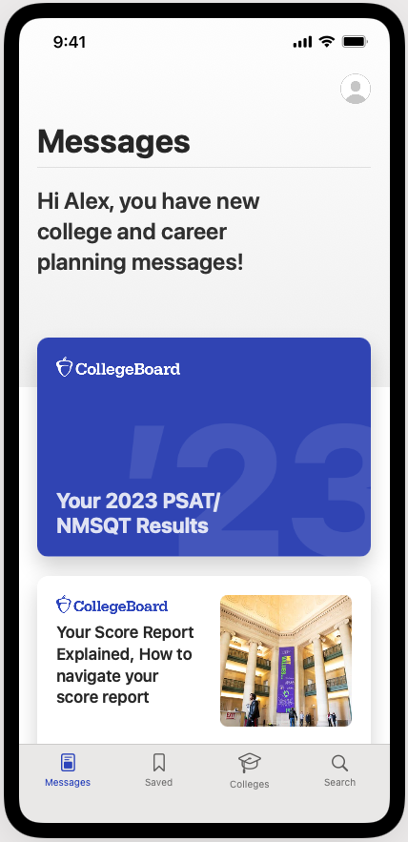
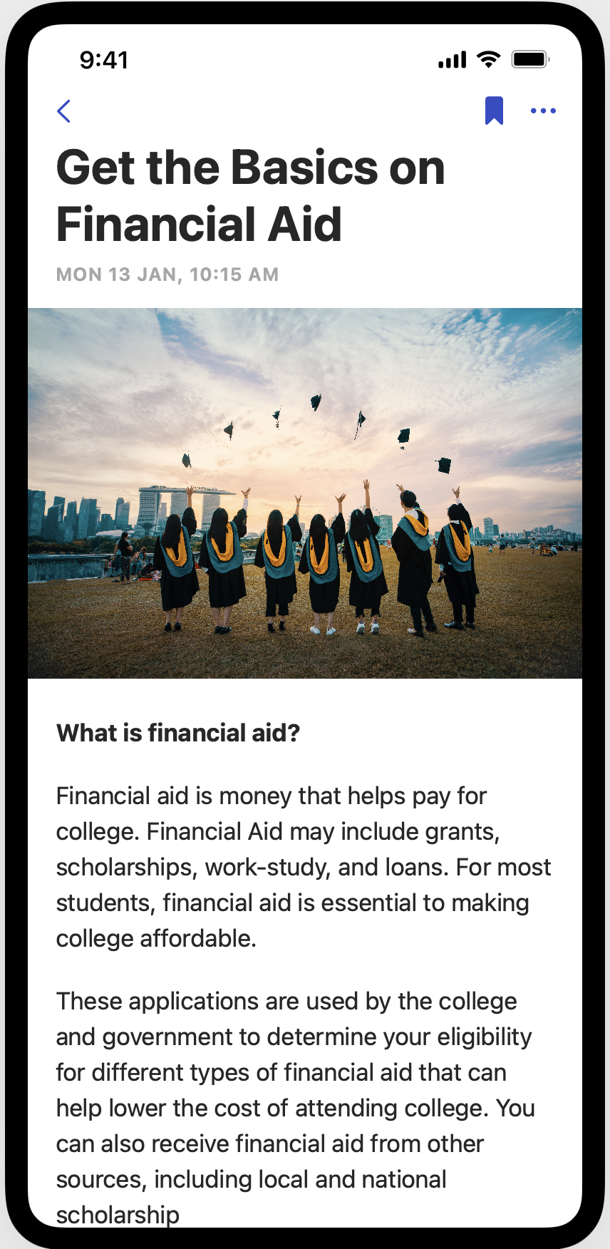
Introducing the BigFuture School Mobile App
The power to plan – in the palm of students’ hands
Direct access to digital PSAT/NMSQT, PSAT10 and SAT School Day scores.
Customized career guidance and information about planning and paying for college.
Connections™—a feature exclusively for school day test takers that allows them to hear from nonprofit colleges and scholarship programs that may be a good match – without sharing personal information.
In early 2024, educators will receive aggregate information and insights about student engagement with the app and its features.
When they test, students can choose to provide a mobile number that will only be used to text them information to access BigFuture School and when scores are available in the app.
Images are illustrative and not final
https://satsuite.org/k12bigfutureschool
Notes:
The transition to digital testing and the changing student data privacy landscape, requires a new way to give students the opportunity to make the most of score release – without having to share their personal information.
The BigFuture School mobile app – available to students 13 and over – helps makes the most moment of score release by providing students with:
Direct access to their scores
Customized career information and guidance about planning and paying for college.
Connections, a feature that allows them to hear from nonprofit colleges and scholarship programs that may be a good match – without having to share personal information. On average, students who choose to connect with colleges are 25% more likely to enroll, and 31% more likely to graduate on time from a four-year college. Those gains are even greater for Black and Hispanic students.
Students who provide their mobile number will receive a text with information needed to access BigFuture School and in-app score availability.
If they opt-in to Connections, they will receive information from nonprofit colleges and scholarship programs. Connections puts privacy first. No personal information is shared with any institutions unless a student chooses to connect and share information directly with them, giving students and their families more control over when, or whether, they raise their hands and be seen.
They’ll be able to opt out any time.
In fall ‘23, BigFuture School and Connections will only be available for digital PSAT/NMSQT, with availability for PSAT 10 and SAT School Day beginning in 2024.
---
REACTIVE
Will students be able to access the app if they don’t provide their mobile number when they take the test?
At this time, providing a mobile number when taking the test is the only way students will be able to access BigFuture School and if they opt-in, Connections. Using a mobile number is the way we ensure we are accurately connecting students with their information. We are exploring other ways for students to access the app in the future.
Will districts and schools have access to the app?
College Board understands and appreciates that districts and schools need insight into how their students are using BigFuture School and Connections. We will be able to provide data and reports on usage of the app in early 2024.

Slide 5
Using BigFuture School and BigFuture
Separate, but complementary, resources to help students plan
Start with BigFuture School
Quickly and directly access scores, planning information, and messages from colleges.
Go deeper on BigFuture.org
Go online for additional resources including a career quiz, college search tool, and more.
Notes:
While BigFuture School and the BigFuture and College Board websites are separate resources, they collectively provide students, parents, and schools with the most convenient and comprehensive set of tools to explore colleges, scholarships, and careers as they plan their path after high school.
We recommend that students who take in-school assessments download the BigFuture School app for a fast, convenient way to get their scores, receive college and career planning information, and access the exclusive Connections feature, right from their mobile phone.
For students who want to explore more deeply, we suggest they use the BigFuture and College Board websites, alongside the info in the BigFuture School app.

Slide 6
Connections
Notes:
Let’s pivot now from the Student experience to Higher Ed as we explore Connections.

Slide 7
Connections – Launching Fall 2023
Connections is a new privacy-forward tool that gives students more control throughout the college exploration process and enables colleges to reach them where they already are—on their mobile device.
With Connections, colleges will engage with the growing number of students who take College Board assessments at their school each year, including the PSAT/NMSQT® and SAT School Day.
Notes:
Connections is College Board’s new student-centric, privacy-forward feature for recruiting students. Connections will help colleges and universities continue to build relationships with in-school test takers (including the PSAT/NMSQT and SAT School Day) without sharing any personal information. Using the mobile app called BigFuture School, students can access their scores, get college and career planning information from College Board, and participate in Connections to hear from colleges, universities, and scholarship programs.
Although there have been changes in test score sending patterns, test-taking continues to remain strong as students have seen great value in taking College Board assessments (specifically the SAT) to strengthen their college applications or to obtain scholarships. {Data taken from the 2022 Grad Survey}. Higher ed Institutions have been seeking ways to engage with students right where they are – on their mobile devices.
So, this is a great win for both students and colleges.

Slide 8
Search and Connections work together to allow students to be seen by nonprofit colleges and scholarship organizations throughout their high school journey
PSAT/NMSQT
SAT School Day
PSAT 10
AP & SAT Weekend
CB Account Creation
BigFuture, SAT Practice & More
Connections
Search
Available to students who take in-school assessments like the PSAT/NMSQT
No personal information is shared unless a student chooses to connect and share information
Customized career information and guidance about planning and paying for college through the BigFuture School mobile app
Available to students as they continue to explore college options
Requires permission to share information like student name, high school, and score range
Colleges and scholarship programs can send information by mail and email
Notes:
When you think about Search & Connections, here are a few helpful reminders:
Search and Connections should be used together to allow students to engage with colleges over time. Connections will allow Higher Ed to communicate with students early in their college exploration process; Search will continue to be used to reach students as they dive more deeply into the college exploration process.
Students taking an in-school assessment (PSAT/NMSQT, PSAT 10, and SAT School Day) will have the opportunity to opt-in to Connections; students taking a Weekend SAT or AP exam will have the opportunity to opt-in to Search. In addition, students may opt-in to Search when they create a CB account, explore BigFuture, or engage in SAT Practice.
It’s important to remember that Connections will contain no student Personally Identifiable Information (PII), protecting student privacy and give students even more control over how they engage.

Slide 9
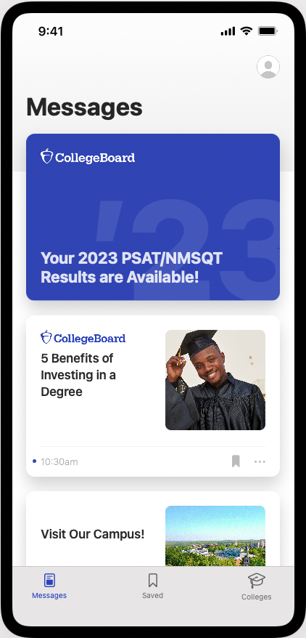
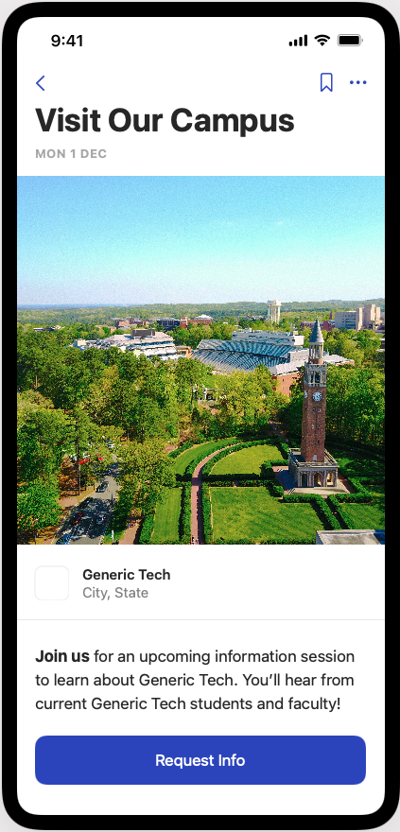
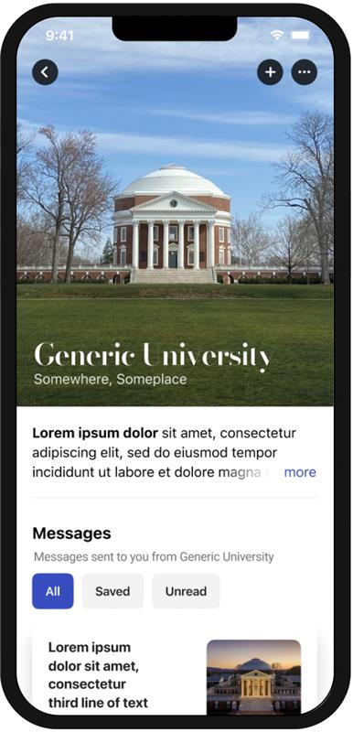
The Student Experience - Connections
Giving students control over the planning process
Score alert
College profile card
College message view
Detailed message view
Navigation icons
Images are illustrative and not final
Notes:
Here what a student might experience if they have opted into Connections
The first screen on the left shows the message feed – which is the core component of the student app. The purple card up top is an alert from College Board to prompt the student to click to view their scores and score report. The second card is a message from Generic University. If a student clicks on that message card, they will be taken to a message detail page.
The second/middle screen show that detail page.
Students can then navigate from messages to college profiles (rightmost screen). They can also search for colleges, access college profiles, and add colleges to their list.
REACTIVE
Will trade organizations be involved?
Only non-profit post-secondary institutions, nonprofit scholarship organizations, and nonprofit educational organizations will participate in Connections. Initially, the majority of participating colleges will be four-year colleges and universities. Students will get information about both community colleges and career pathways. We’ll continue to build and improve this new experience for students over the next few years, adding more features and options such as connections to career training programs. Our long-term goal is to create richer college and career connections for all students, including those who aren’t on traditional four-year pathways.

Slide 10
Appendix

Slide 11
Pilot Student Feedback
This app is a great tool for students who are on their college-search journey. The “Interested in You” feature is a great addition because it gives insight to schools a student may not have initially looked into. The feature of saving messages is also a great tool because it will help students not lose important information they might forget about. Having scores be easily accessible is another great idea. Ultimately this is a great app!
“Works great so far, love the news option. Hoping college search will soon be added. Saving/ bookmarking news is great!”
“5 star schoolin’ experience!”
My experience was great, I loved that the front page was about the results. The colleges immediately being under the results was stressful but apart from that it was great. The message toggle was fine too.
“I absolutely love how user-friendly it is! The interface is simple yet appealing to the eye. The structure of the app is also studiously compelling! It would be good if you guys were to put SAT/ACT testing dates, etc on there too! Other than that, I love this app already and can’t wait for it!”
“Overall, my experience testing out the app was excellent and easy to access. I am so excited for when the app is finally ready to launch!
Notes:
Here you’ll see the responses from some of the students who piloted the mobile application in early September.

Slide 12
Search is Good for Students
23%
more likely to apply
at four-year colleges than similar students who aren’t identified through Search.
34% | For Hispanic students
25% | For Black students
24% | For American Indian/Native Alaskan students who receive outreach via Search
31%
more likely
to graduate
in four years than
similar students who
weren’t identified through Search.
Enrollment
25%
more likely to enroll
at four-year colleges than similar students who aren’t identified through Search.
43% | For Hispanic students
40% | For Black students
48% | For American Indian/Native Alaskan students who receive outreach via Search
Completion
Enrollment & Completion: Howell, Hurwitz, Mabel & Smith (2021): https://cbsearch.collegeboard.org/pdf/college-outreach-and-student-outcomes.pdf
Notes:
Topline:
When students receive outreach from a college through Search, they are 23% more likely to apply to that college compared to identical students who did not receive outreach from that institution via Search.
Another study demonstrates that when compared to their statistically identical peers, students who connect with colleges via Search are 25% more likely to enroll in a four-year college and 31% more likely to graduate in four years than similar students who aren’t connected to colleges via Search.
Comparative Data on other racial subgroups:
Application: This compares to 14% increase for White students and 11% increase for Asian students. This study did not examine other racial subgroups.
Enrollment: The comparative statistics for other racial groups: Asian: 15% gains, Hawaiian/Pacific Islander: 26% gains, White: 22% gains
Completion: The comparative statistics for other racial groups: Asian: 28% gains, White: 28% gains

Slide 13
The Shifting Landscape: Maintaining the Power and Value of Connecting Students to College Opportunity
Counselors, schools, districts, and states value the connection to colleges that the PSAT and SAT assessments provide.
Students/families are positively impacted when they receive direct outreach from colleges
Robust research shows the large scale and significant impact of college outreach on student’s educational trajectories
With the increasing focus by regulators (and consumers) on restoring data privacy, enrollment leaders will need to adapt
The fast-changing recruitment landscape has already impacted colleges, and that will only continue

Slide 14
Students will be able to opt in to BigFuture School and Connections during their testing experience in Bluebook
Example Only – still in development

Slide 15
Accessing BigFuture School
1
2
Provide a Mobile Number
Access BigFuture School Mobile App
During the testing experience for the digital PSAT/NMSQT, PSAT 10, and SAT School Day, students 13 and over can provide a mobile number to receive text messages about the BigFuture School mobile app and score availability. The mobile number will only be used to text students’ information to access BigFuture School and when scores are available in the app.
Students can view their scores, along with customized guidance on potential career paths, and information about planning and paying for college. When they opt-in to Connections, they can begin hearing from nonprofit colleges and scholarship and educational organizations.

Slide 16
All Centered on Students
Meet Carolina
Key Moments
Test Day
Score Release
Learning about careers and college planning
Connecting with colleges
10th Grade
Located in Tennessee
High achiever
Interested in STEM
Unfamiliar with college process
Taking Fall PSAT/NMSQT
Notes:
Everything we do is ultimately designed to deliver maximum value to our students
So, in that spirit, we want to take you through the experience through the lens of serving Carolina – a 10th grader, in TN, ….
There are several important moments coming up for Carolina, test day, score release, etc, but right now she's busy getting ready for the Fall PSAT/NMSQT

Slide 17
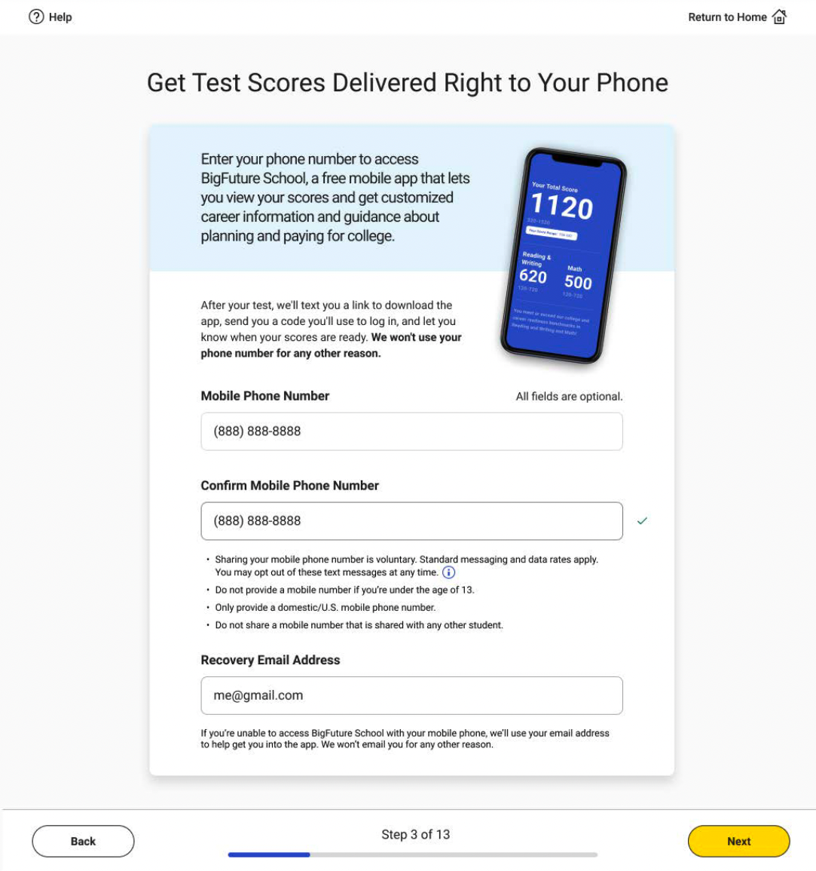
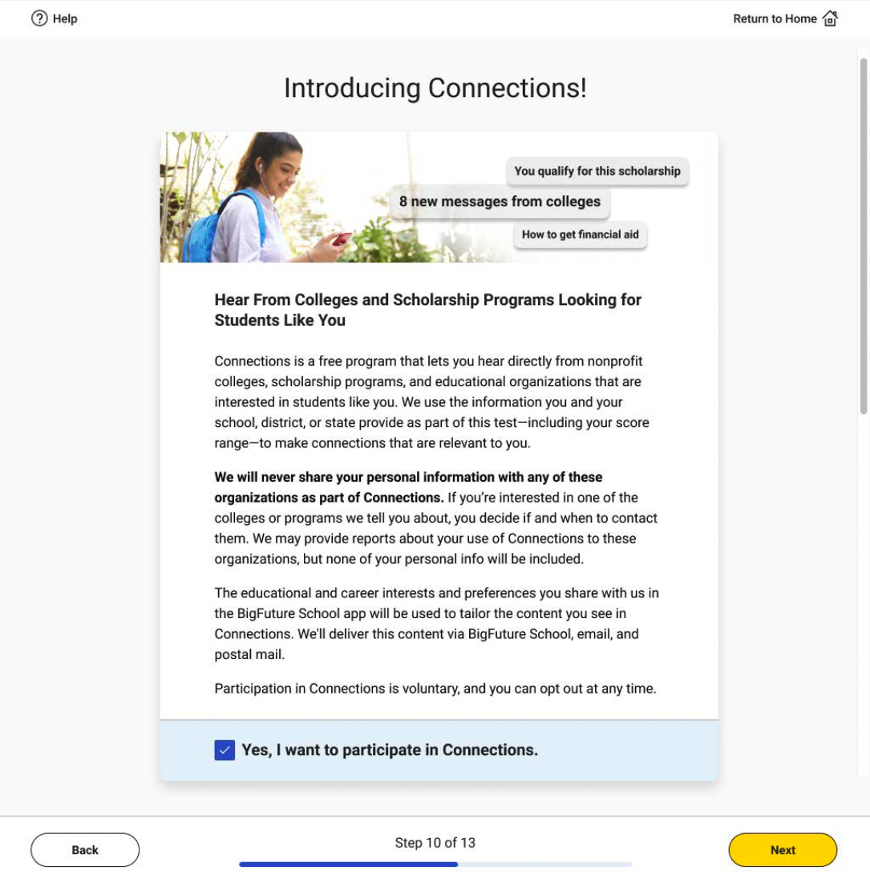
It’s Test Day! (Signing-up for BigFuture School & Connections)
As part of getting set-up and ready in Bluebook to take the PSAT/NMSQT, Carolina is given the option to get a text to download BigFuture School and sign-up for Connections
Carolina gets set-up in Bluebook
Notes:
Now it’s test day. Prior to, or on test day, she launches the Bluebook Testing app and gets set-up and ready for her test.
As part of the set-up process, Carolina will be introduced to BigFuture School and Connections, and be given the opportunity to sign-up for both
Like most students, Carolina is very excited about getting her scores and hearing from colleges, and she loves the convenience of the app, so she signs-up for both

Slide 18
Downloading BigFuture School
Carolina is excited to have achieved this milestone and is looking forward to getting her scores, exploring careers, and getting trusted advice about planning for college
Text provides Carolina with a link to download the BigFuture School app from the app stores. Texts will be sent outside school hours.
Carolina is an iOS user, so the text sends her to the Apple App Store to download the app. BigFuture School will also be available on Android.
Carolina is among the 91% of students recently surveyed that indicated they are likely to download the app and benefit from what it has to offer.
Carolina finishes her PSAT/NMSQT
She submits her test, gets a text for BFS
She downloads BigFuture School
Carolina launches the BigFuture School
Notes:
Fast-forward and Carolina is at home enjoying some downtime on her phone – she finished and submitted her test earlier in the day and is feeling pretty good.
Carolina gets a text from College Board congratulating her and providing her with a link to download the BigFuture School app.
Carolina's eager to be ready to get her scores, and take advantage of Connections and the career and college guidance in BigFuture School, so she downloads the app

Slide 19
Carolina starts using BigFuture School
Carolina is ready to take advantage of all that BigFuture School has to offer, the convenience of getting her scores on her phone, the value of career and college guidance, and access to Connections
Notes:
When Carolina launches the app she will be asked to provide the phone number and a code that will be texted to her. This is what we call positive friction, where we're clearly signaling the care with which approach our students and their data
As part of onboarding Carolina also opts-in to Push Notifications as she's eager to hear when her scores are available, and when there's new and interesting content in the app for her.
At this point, Carolina is now in the main part of the app (the Messages feed) where, before her scores are out she will get career and college planning guidance from BigFuture, and we'll help her get the most out of the app.
Now, we fast forward to score release day. Carolina's had a busy day, but she's incredibly excited when she gets a push notification telling her that her scores are available.
She taps on the push notification and is taken directly to her score report. This experience delivers the core information of the score report, in an elegant, mobile friendly way.
At the end of the score report, Carolina now sees that she has several schools that are interested in her waiting with messages in her feed, and she also has more career and college guidance
Carolina heads over to the messages feed and sees the message from institutions.
She clicks on the message and decides she wants to save it for later
She wants to see more from the school, so she clicks on the school name and goes to their profile. Here, Carolina can see all the messages she's received from the school. She's definitely interested, so she adds this school to her own personal list.
As Carolina uses the app, she'll continue to add schools to her personal list and save important messages – both of which she'll be able to access in the Colleges and Saved sections.

Slide 20
More Ways to View Scores
Students who don’t opt in to BigFuture School or who don’t have a mobile phone can still access their scores and planning information. Students who take the SAT on the weekend will continue to receive their scores through their College Board account.
Get Score Reports
Schools will continue to receive PDF score reports for all assessments they administer, which they can share with students. The information on the reports will be similar to the information in the app.
Use a College Board Account
As always, students can log in to their personal College Board accounts at studentscores.collegeboard.org to get additional insights about their scores and explore BigFuture.

Slide 21
Opportunities for Students to be Seen by Colleges
Advanced Placement
SAT Weekend
BigFuture List Building
Official SAT practice through Khan Academy
College Board Account Creation and Log-in
National Recognition Programs
Big Future Days
Real Talk
Search
SAT School Day
PSAT/NMSQT
P10
Connections
Notes:
Given the needs of today’s students, we have created strong participation in Search with new digital opt-in channels that allow students to be in the driver’s seat and decide when they are ready to join Search -- regardless if they have taken a College Board assessment yet or not. This is a pretty big shift from where we started with massive data loads just from the SAT, PSAT and AP exams.
Beginning in Fall 2023, students who take in-school assessments such as the PSAT/NMSQT and SAT School Day will have the opportunity to connect with colleges, universities and scholarship organizations through Connections – without sharing any personal information.
Students who participate in AP, take the SAT outside of the School Day, create college lists through BigFuture, practice for the SAT through Khan Academy, create a College Board account or attend a College Board–sponsored event will have the opportunity to opt-in to Search.
Reactive: Info about National Recognition Programs (NRP):
A student has several steps to take before they are invited into NRP, which would then get them into Search. Before that happens, they must meet the following criteria:
Sophomores
Must have a 3.5 GPA or higher at the time they are applying. Weighted and unweighted GPAs are considered.
Must have a permanent address in the United States, a U.S. territory or U.S. military base, or attend a Department of Defense Education Activity (DoDEA) school. U.S. citizenship is not required.
Must identify as Black, African American, Latino, Hispanic, Indigenous, Native, or attend high school in a rural area or small town.
Must have taken the PSAT/NMSQT in fall 2022 OR at least 2 distinct AP Exams in 8th or 9th grade.
Juniors
Must have a 3.5 GPA or higher at the time they are applying. Weighted and unweighted GPAs are considered.
Must have a permanent address in the United States, a U.S. territory or U.S. military base, or attend a DoDEA school. U.S. citizenship is not required.
Must identify as Black, African American, Latino, Hispanic, Indigenous, Native, or attend high school in a rural area or small town.
Must have taken the PSAT 10 in spring 2022 OR the PSAT/NMSQT in fall 2022 OR at least 2 distinct AP Exams in 8th, 9th, or 10th grade.

